Slide 1

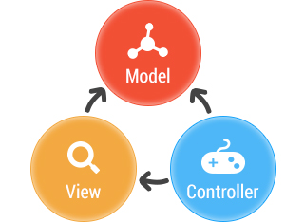


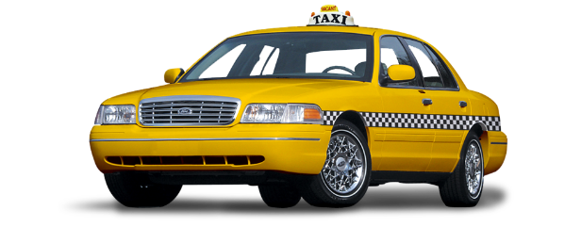
PROBLEM
MVC
PATTERN
STYLE
CONTEXT
CLIENT/SERVER

